Slide 1
Bonita Update
Manage Patches

Slide 2
Introduction
Bonita update is a tool to install patches
Patches delivered by the R&D, or support
Automate installation for customer
Allow a de-installation
Show the list of available patches on Bonita Reference server
Show the list of installed patches on the customer server
Public patches, private patches
A patch can be public, or private (to only one customer)
Multi version
The mechanism handle all Bonita Version

Slide 3
Packaging for the customer
The function is a Custom Page, available on the community
Customer can download it
Each servers must install the page
Bonitasoft provides
Information to connect to the “Reference server”
A login / password to get patches
Customers can then use the function
Access list of available patches
Download, install

Slide 4
On Bonitasoft side
Bonita has a download server
Its name is “tango”.
Why? Hum…. Why not?
The reference server contains all patches
All patches, all revisions
To access it, a customer need to have a login password
Same approach as the customer portal
Bonita can then control who access to patches
Bonita can deliver some private patches.
This server is… a Bonita Bundle,
Drink our champagne.

Slide 5
Download from the Reference server
Customer
Bonita Server
7.10
7.8
7.9
Downloaded
Download
7.10
Client 1
Client 2
Bonita Reference (Tango)

Slide 6
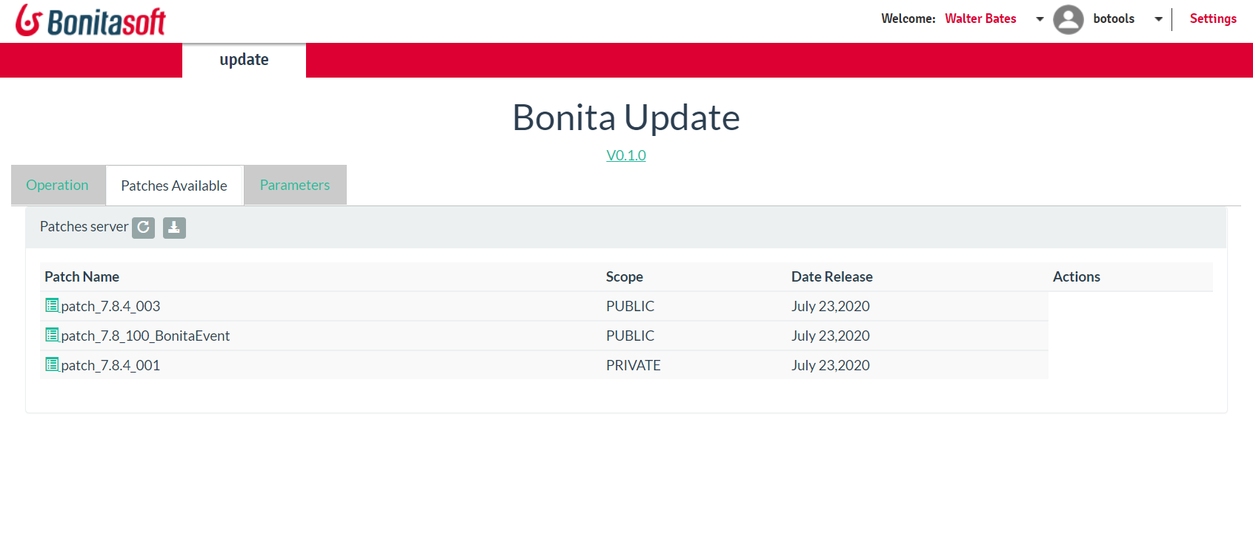
Download from the server
List of patches are visible
Users click on the “download” button to get them locally

Slide 7
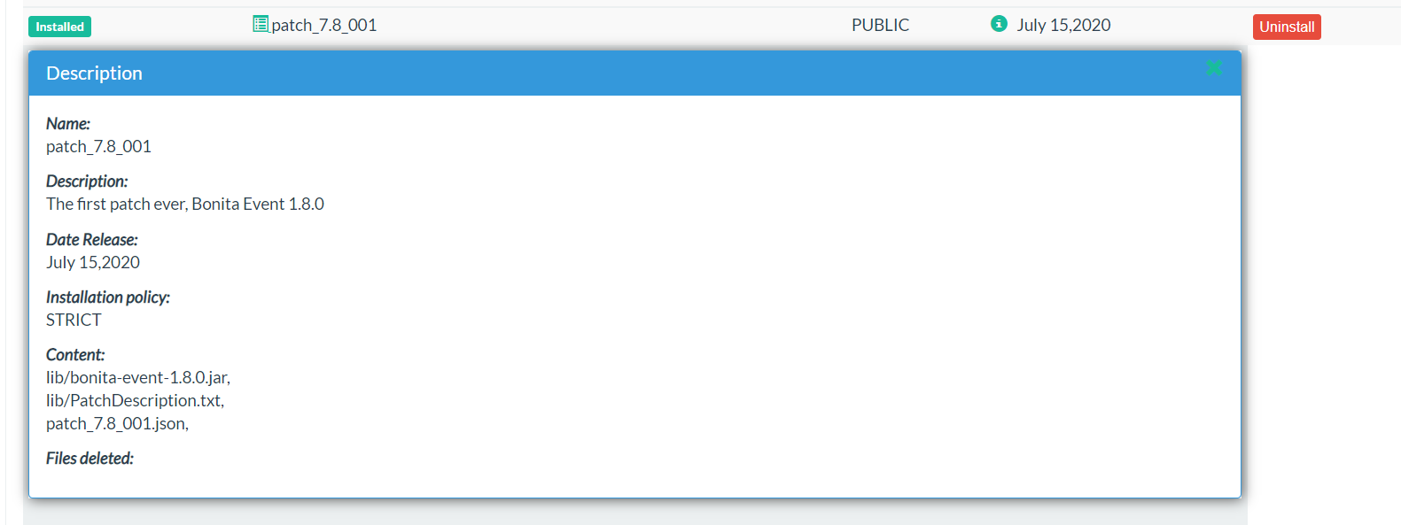
Path information
Administrator access patch information

Slide 8
Install, uninstall
A customer can install a patch from the list
Patches are downloaded in the “Downloaded” box
On a button, he install it
Then patch in installed
A Uninstall procedure is created
User can uninstall a patch on a button
Downloaded
Installation
Deinstallation
UnInstall ZIP
Installed

Slide 9
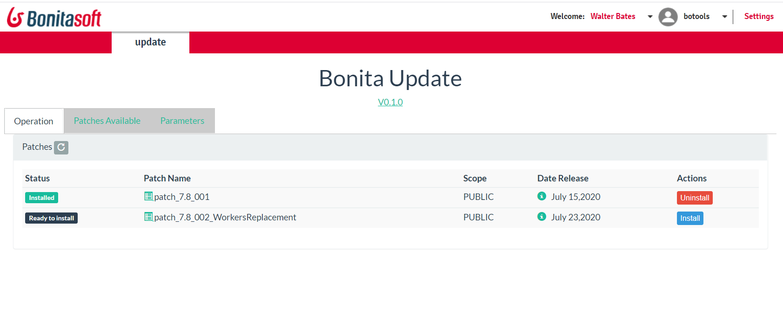
Install, uninstall
Install or uninstall in a click
All patches are listed in the same tab. Have multiple tabs?

Slide 10
Allow the “patch validation”
Customer wants to install on a preproduction
Test, validates the patch
Then install on production after
And install the same patch, not download it again
Architecture
The “Reference server” of the production is the Preproduction
Accessible patch are the only one on the pre-production
Download is made from the Preproduction server

Slide 11
Pre production - production
Customer (Production)
Bonita Server 7.9
Customer (Pre production)
Bonita Server 7.9
Bonita Patches (Tango)
Downloaded 7.9
Downloaded
Download

Slide 12
How to build a Patch?
A Patch is a ZIP files
It contains any files under Tomcat
Jar file
Resource files
A JSON file describe the patch
Description of the content
Files to deleted
Files to update

Slide 13
A patch can update information
Some patch may need to update a configuration file
Increase the number of workers
Change a properties in server.xml
Change a properties in bonita.xml
The JSON Description file pilot the change
“file” : “platform_portal/security-config.properties”
“key”: “security.csrf.enabled”
“Value“: “false”
Previous value are saved in the de-installation

Slide 14
Patch sequence
Sequence is mandatory in a patch
Installer keep the sequence : path 12 must be installed before path 13
Deinstallation keep the sequence : patch 13 must be deinstall before patch 12
A patch can contain then only the new delta, not all files from the beginning

Slide 15
Private patch
A Private patch is identified by the Reference server based on the login used
Private patches are installed AFTER a public patch
Private patches have a sequence too
To install the Public patch 14
Deinstall all private patches
Install patch 14
Re-install all private patches
A private patch becomes public?
The strategy works, the private patch does not exist anymore then will be deinstall, never reinstall

Slide 16
Bonita Reference Server
Install the Bonita Update page on a server
The page contains all methods to be a Reference server
That’s why a Preproduction server can be a reference for a Production server
Create one login per customer
Patches have to be upload manually on the server
Directory <tomcat>/server/patches/reference/<BonitaVersion>

Slide 17
What’s next?
Install a Tango server
Get a Bonita server (any version)
Install the Bonita Update page
Generate patches
Play with it, on your studio, on any Bonita server
Install the Bonita Update page
Download/Install/Uninstall
Take the decision to use it
Specify improvements

Slide 18

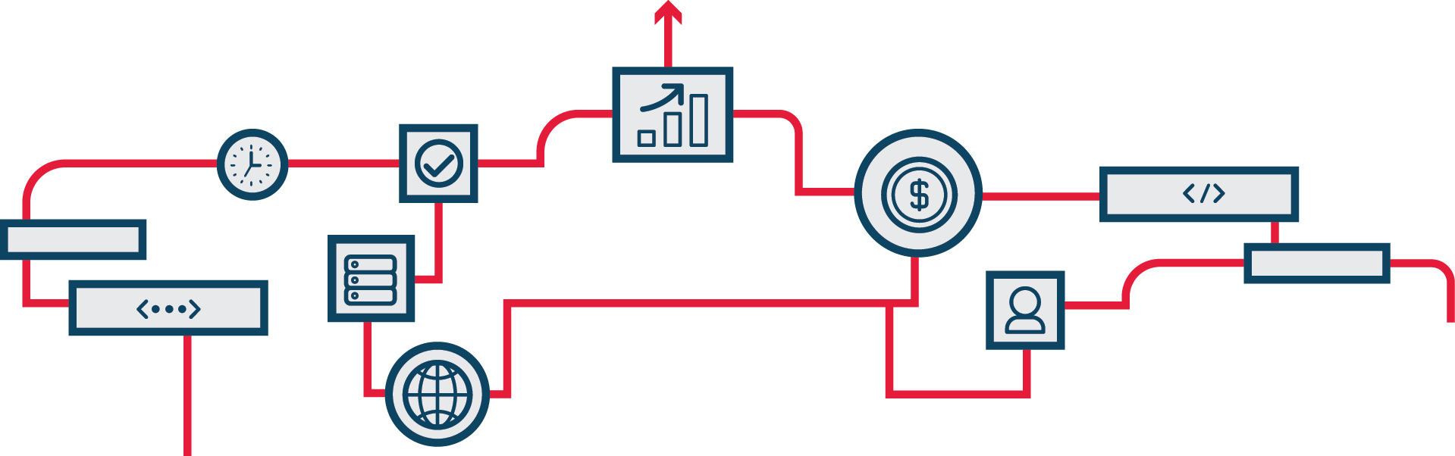

Thank you.

